Slide 1





Home Irrigation Control System (HICS)
SRS Gate Review
November 5, 2014
Belachew
Haile-Mariam(L)
Gautam
Adhikari
Jeremiah
O’Connor
Tung
Vo
Notes:
This presentation demonstrates the new capabilities of PowerPoint and it is best viewed in Slide Show. These slides are designed to give you great ideas for the presentations you’ll create in PowerPoint 2010!
For more sample templates, click the File tab, and then on the New tab, click Sample Templates.

Slide 2

Product Concept
1
Tung

Slide 3
Product Concept
What is the product?
HICS is an intelligent home irrigation system that collects soil moisture readings from in-ground sensors and analyzes the data to determine the necessary amount of water needed for the user’s lawn
What problem does it solve ?
This product is made to make home irrigation easier by providing customers with an automated and smart watering solution that helps with water conservation while providing remote access through an easy to use web application

Slide 4
Product Concept
Who is the intended audience?
Home owners that either have or plan on installing a sprinkler system
The irrigation/landscaping companies that install sprinkler systems for their customers
Water conservationists
Individuals who find themselves away from their homes for extended periods of time
What does is look like?
The product looks like the sprinkler controller box on most sprinkler systems only HICS has no front facing button or interface on the controller.

Slide 5
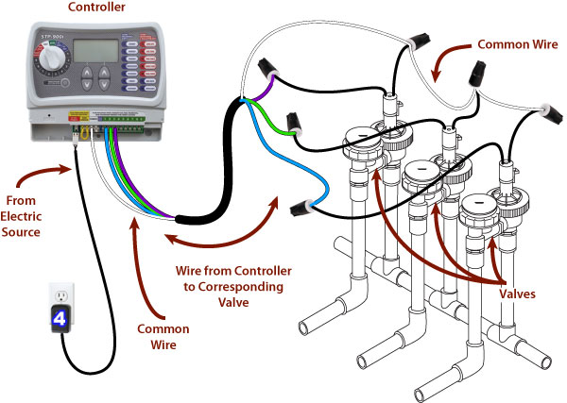
Product Concept
What does is look like?
Regular Home Irrigation System

Slide 6
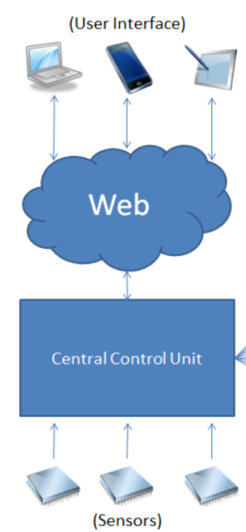
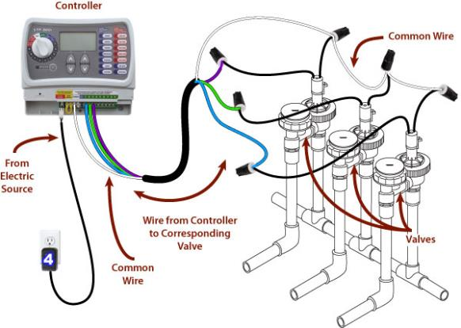
Product Concept
Existing Irrigation System
SmartGrass - Home Irrigation Control System

Slide 7
Product Features and Functional Overview
2
Tung

Slide 8
Product Features and Functional Overview
Soil Moisture Reading: The sensors monitor soil moisture levels in the user’s lawn and sends that information to the central control unit.
What does the product do and what are its critical functions?
Web Services: HICS utilizes a web server to store all soil readings from the microcontroller, analyzed to determine what water amounts the lawn requires and allows the user to adjust the watering schedule accordingly.

Slide 9
Product Features and Functional Overview
Remote Control: A web application will provide control features to adjust watering schedules, read and record data collected by the moisture sensors, and turn the sprinkler valves on and off. This will allow the user to maintain complete control over their home irrigation system regardless of their physical location.
What does the product do and what are its critical functions?
Scheduling: Users will be able to create and edit watering schedules for the HICS via its mobile web application. The web server will provide its own suggested watering schedule that will be created based on soil moisture levels, upcoming and current weather conditions, and previous watering history.

Slide 10
Product Features and Functional Overview
Local Weather Analysis: The user can set to override watering based on reports from an included rain sensor. HICS will not operate when it is raining at the systems location.
What does the product do and what are its critical functions?
Web Application with Scalable Interface: The web application will be built with scalability in mind to enable the same functionality on a mobile device as it would on a desktop computer.

Slide 11
Product Features and Functional Overview
What does the product do and what are its critical functions?
Registration and Account Management: Each HICS controller will be given a unique serial number that will be used for registration purposes. Once the user creates an account and registers their device they will be granted full access to interface with their device via the web application.
Yes. HICS is only usable if the customer currently has an existing sprinkler system or plans to install one in the near future.
Does the product have any restraints?

Slide 12

Required Inputs and Output
3
Jeremiah

Slide 13
Required Inputs and Outputs
Name | Data Flow | Description | Use
Soil Moisture Sensors | Output | The sensors send the soil moisture levels to the central control unit. | The moisture levels are used to determine the amount of water the lawn needs.
Rain Sensor | Output | The sensor sends an alert signal to the central control unit when it detects rain. | The rain sensor is used to alert the central control unit of rain so that the valves can be shut off to conserve water.
Central Control Unit | Input / Output | The central control unit relays data between the web server, sensors, and valves. | The unit sends the sensor readings to the web server and receives control commands to toggle the water valves.
Web Server | Input / Output | The server communicates with all devices and stores all information. | The server relays data between the application and central control unit.
Application – Create/Update Account | Input | The user will be able to create/modify an account associated with a device. | The user account is used to login and monitor/control a device.
Application – Create/Update Schedule | Input / Output | The watering schedules communicate with the web server to start/stop watering. | The watering schedules are used to determine when to water the lawn and for how long.
Application – Login | Input | The user must login with their registered username and password to access the application. | The user login is required to provide security for controlling a HICS device.
Application – Power | Input | The user inputs an action to immediate start or stop watering. | The water valve will toggle between open and closed to start or stop watering.
Application - Reports | Input / Output | The user inputs parameters to display specific data from the web server. | The user can generate reports to display information about current/past soil reading and watering schedules.

Slide 14
User Interface
4
Tung

Slide 15
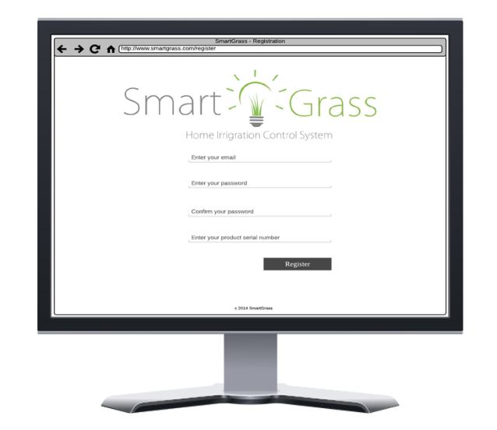
User Interface Requirements
User Registration Interface

Slide 16
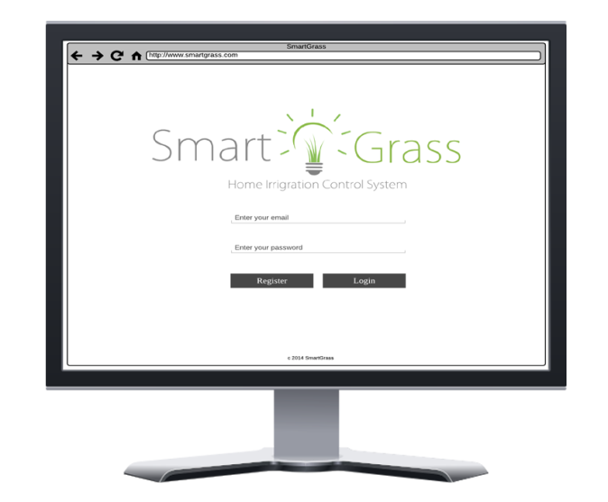
User Interface Requirements
User Login interface

Slide 17
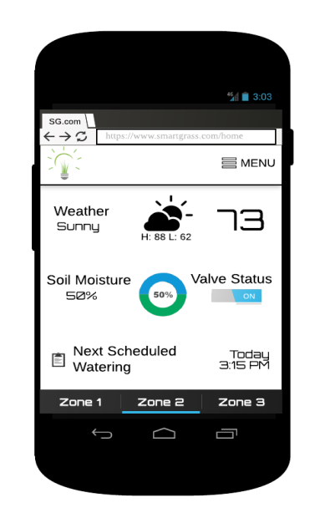
User Interface Requirements
Home Dashboard interface

Slide 18
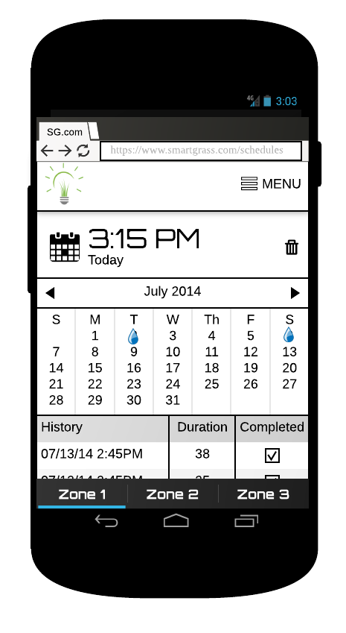
User Interface Requirements
Scheduler Interface

Slide 19
Customer Requirements
5
Jeremiah

Slide 20
Customer Requirements
What are the most critical functions of this product from a customer perspective?
1. Central Control Unit
Description: The central control unit is responsible for all communication between the web application, soil moisture sensors, and water valves. The control unit will transmit the readings from the soil moisture sensors and report the data to the web application. The control unit also controls the water valves, which sets the flow of water to the sprinkler system.
Constraints: Wires from the water valves must be plugged into the control unit. The control unit also requires power from an outlet and must be connected to the internet.
Standards: NEMA 5–15R power connector, cat5e Ethernet connector
Priority: 1 – Critical Priority

Slide 21
Customer Requirements
What are the most critical functions of this product from a customer perspective?
2. Soil Moisture Sensors
Description: In-ground sensors that monitor and report soil moisture levels.
Constraints: Must be connected directly to the central control unit and must be placed in the ground in close proximity to an irrigation zone.
Priority: 1 – Critical Priority

Slide 22
Customer Requirements
What are the most critical functions of this product from a customer perspective?
3. Web Application
Description: The web application will be used to interface with the central control unit. The application is responsible for scheduling watering times as well as interfacing with the central control unit to control the water valves. The web application will be built with a scalable interface to enable the same functionality on a mobile device as it would on a desktop computer while maintaining a similar look and feel.
Constraints: Must be hosted on an online server and maintain a maximum uptime. Access to the application requires an internet connection and a supported web browser.
Priority: 1 – Critical Priority

Slide 23
Customer Requirements
What are the most critical functions of this product from a customer perspective?
4. Watering Scheduler
Description: The web application can schedule watering times and durations for the sprinkler system. The scheduler will display upcoming watering schedules and allow users to create, edit, or delete them.
Constraints: None
Priority: 1 – Critical Priority

Slide 24
Customer Requirements
What are the most critical functions of this product from a customer perspective?
5. Soil Moisture Reports
Description: The web application will generate visual reports of the current soil moisture levels. The reports will be generated as graphic representations of the data and will be filterable by zone, year, month, and day.
Constraints: None
Priority: 3 – Moderate Priority

Slide 25
Customer Requirements
What are the most critical functions of this product from a customer perspective?
6. User Login
Description: The user must login to the web application using the correct credentials to be able to remotely control features of HICS.
Constraints: The user must have an active internet connection and access to a supported web browser on their device. Additionally, a user account and correct credentials must be provided in order to login.
Priority: 1 – Critical Priority

Slide 26
Customer Requirements
What are the most critical functions of this product from a customer perspective?
7. Active Status
Description: The web application will have a status indicator on the home dashboard to display whether a zone is actively being watered or not.
Constraints: None
Priority: 4 – Low Priority

Slide 27
Customer Requirements
What are the most critical functions of this product from a customer perspective?
8. Rain Sensor
Description: An external rain sensor will monitor the weather conditions and will send an alert to the central control unit in the event of rain. The user preferences will dictate whether this event will turn the sprinklers off or not.
Constraints: Rain sensor must be mounted outside and connected to the control unit.
Priority: 2 – High Priority

Slide 28
Customer Requirements
What are the most critical functions of this product from a customer perspective?
9. Web Hosting Server
Description: There will be a server hosting our web application with an associated URL for domain user access.
Constraints: A subscription to a web hosting service must be acquired. A URL must also be registered and associated with the domain.
Priority: 1 – Critical Priority

Slide 29
Customer Requirements
What are the most critical functions of this product from a customer perspective?
10. Database Management System
There will be a DBMS that will store all data from soil sensor readings as well as all the information for the web application. This information includes user account information, settings, reports, and weather data necessary for the application to perform as expected.
Constraints: None
Priority: 1 – Critical Priority

Slide 30
Customer Requirements
What are the most critical functions of this product from a customer perspective?
11. Device Registration
Description: A user must register their HICS device with their account in order to interface with it via the web application. The central control unit will have a unique serial number on it that will be used to register the device to a user account.
Constraints: The central control unit must have a valid serial number on it in order for a user to register the device.
Priority: 2 – High Priority

Slide 31
Customer Requirements
What are the most critical functions of this product from a customer perspective?
12. Region Grouping
Description: A user may group their sprinkler zones into regions through the web application. This functionality will allow the user to setup watering schedules for multiple zones at once without having to configure each individual zone.
Constraints: Each zone will have exactly one valve and each region must contain a minimum of one zone.
Priority: 3 – Moderate Priority

Slide 32
Customer Requirements
What are the most critical functions of this product from a customer perspective?
13. Auto Off
Description: The user can set an auto off timer via the web application that terminates watering if the duration lasts longer than the set time.
Constraints: None
Priority: 3 – Moderate Priority

Slide 33

Packaging Requirements
6
Billy

Slide 34
Packaging Requirements
What will be physically delivered to the customer?
1. Control Unit Housing
Description: The components of the control unit, including its accessories, will be contained inside a mountable hard plastic container.
Constraints: This component needs to be wall mountable and must be packaged in a convenient form factor for the user.
Priority: 1 – Critical Priority

Slide 35
Packaging Requirements
What will be physically delivered to the customer?
2. Soil Moisture Sensors Packaging
Description: (4) Soil sensors will be included in the final packaging of HICS. They will be located within their own boxes and will have corresponding documentation that describes their proper installation. The user will be able to purchase additional soil moisture sensors and add them to their system.
Constraints: The user will be responsible for the proper installation of the soil sensors according to the included instructions.
Priority: 3 – Moderate Priority

Slide 36
Packaging Requirements
What will be physically delivered to the customer?
3. Rain Sensor Packaging
Description: (1) Rain sensor will be included in the final packaging of HICS. It will be located within its own box and will have corresponding documentation that describes its proper instillation.
Constraints: The user will be responsible for the proper installation of the rain sensor according to the included instructions.
Priority: 3 – Moderate Priority

Slide 37
Packaging Requirements
What will be physically delivered to the customer?
4. Connecting Cables
Description: (1) Power cable and (1) Ethernet cable will be included in the packaging of HICS. Their intended purpose is to be used with the central control unit.
Constraints: None
Standards: NEMA 5–15R power connector, cat5e Ethernet connector
Priority: 3 – Moderate Priority

Slide 38
Packaging Requirements
What will be physically delivered to the customer?
5. Software Application
Description: The HICS software should be a stand-alone web application that requires no set up from the user. The user must register an account with a valid product serial number to access the web application. Once they are logged into their account and their device has been connected, they will be able to access the features of the HICS.
Constraints: The user needs an active internet connection in order to interface with the web application. The central control unit must be connected to the internet via the included Ethernet cable and registered with the user’s account before it can be controlled.
Priority: 1 – Critical Priority

Slide 39
Packaging Requirements
What will be physically delivered to the customer?
6. User Manual
Description: A user manual will be presented to the user that details the use and operation of HICS. It will be provided in the final packaging as a CD-ROM and will also be made available online via the web application.
Constraints: The manual will only be provided in English.
Priority: 3 – Moderate

Slide 40
Performance Requirements
7
Billy

Slide 41
Performance Requirements
How does performance affect the product?
1. Sensor Accuracy
Description: Proper sensor readings of soil moisture levels must be captured to ensure accurate and efficient watering schedules. This requires solid construction of the sensor modules and proper software analysis of the data provided by the sensors.
Constraints: Soil moisture sensors must be properly installed according to the provided instructions.
Priority: 2 – High Priority

Slide 42
Performance Requirements
How does performance affect the product?
2. Rain Detection
Description: In the event of rainy weather, the rain sensor must quickly transmit an alert to the control unit to interrupt or delay any active watering.
Constraints: The rain sensor must be properly placed and installed in order to ensure this functionality.
Priority: 3 – Moderate Priority

Slide 43
Performance Requirements
How does performance affect the product?
3. Communication Between the Web Application and Central Control Unit
Description: The user will be able to set watering schedules through the web application to send a signal to the central control unit to initiate watering. This must happen in a timely manner to ensure consistency between the scheduled start/end times and the actual start/end times.
Constraints: None
Priority: 2 – High Priority

Slide 44
Performance Requirements
How does performance affect the product?
4. Communication Between the Soil Moisture Sensors and Central Control Unit
Description: The soil moisture sensors will communicate with the central control unit to relay information about soil moisture levels. This must be accomplished periodically in an accurate and timely manner in order to avoid errors and to ensure consistency throughout the system.
Constraints: None
Priority: 2 – High Priority

Slide 45
Performance Requirements
How does performance affect the product?
5. Device Power Malfunction
Description: If the server fails to receive communication from the central control unit for a specified period of time, it will notify the user that the system is offline.
Constraints: Control unit must be without power for a specified period of time.
Priority: 3 – Moderate Priority

Slide 46

Safety Requirements
8
Gautam

Slide 47
Safety Requirements
How does the product handle safety concerns?
1. Soil Moisture Sensor Insulation
Description: The electronic components of the soil moisture sensors must be properly insulated against external environmental conditions. This is to ensure that they do not malfunction while in use.
Constraints: None
Priority: 2 – High Priority

Slide 48
Safety Requirements
How does the product handle safety concerns?
2. Central Control Unit Temperature
Description: Efficient air flow and low temperatures must be established while the central control unit is in operation. Computer fans and proper ventilation in the housing container will be used to cool the device and prevent it from overheating and possibly starting a fire.
Constraints: None
Priority: 2 – High Priority

Slide 49
Safety Requirements
How does the product handle safety concerns?
3. Proper Wiring of Central Control Unit
Description: The central control unit will be powered from an external wall plug. The source will be 120v and improper wiring could leave the user exposed to currents in the range of 15-20 amps. It is crucial that the control unit is wired properly to accept this input and cause no harm to the device or the user.
Constraints: None
Standards: NEMA 5–15R power connector
Priority: 1 – Critical Priority

Slide 50
Maintenance and Support Requirements
9
Gautam

Slide 51
Maintenance and Support Requirements
How will the product be maintained and supported?
1. Sensor Maintenance
Description: The soil and rain sensors will be replaceable in the event of hardware failure.
Constraints: Replacement sensor must be compatible with the device.
Priority: 2 – High Priority

Slide 52
Maintenance and Support Requirements
How will the product be maintained and supported?
2. Software Maintenance
Description: All source code files and relevant documentation must be available for software maintenance and troubleshooting. The required files and documentation will be available via the GitHub repository. The software will be split into loosely coupled parts so it would be easier to make changes and improvements to the system over time.
Constraints: None
Priority: 3 – Moderate Priority

Slide 53
Maintenance and Support Requirements
How will the product be maintained and supported?
3. Source Code Documentation
Description: All source code files required for HICS will be extensively commented to support future updates and troubleshooting.
Constraints: None
Priority: 3 – Moderate Priority

Slide 54
Maintenance and Support Requirements
How will the product be maintained and supported?
4. Scalability
Description: The central control unit will support adding additional valves or soil sensors.
Constraints: The central control unit will support up to thirty-two valves and thirty-two corresponding soil sensors.
Priority: 2 – High Priority

Slide 55
Other Requirements
10
Gautam

Slide 56
Other Requirements
1. Mapping the Soil Moisture Sensors to Irrigation Valves
Description: HICS requires that the user properly maps the soil moisture sensors to the irrigation valves. The central control unit will feature a diagram showing the one-to-one relationship between soil moisture sensor inputs and irrigation valve inputs.
Constraints: The user must follow the included diagram and instructions to properly map the sensors and valves.
Priority: 1 – Critical Priority

Slide 57
Other Requirements
2. Browser Support
Description: The web application should be scalable and responsive in all of the latest versions of Mozilla Firefox, Google Chrome, and Internet Explorer.
Constraints: Versions of Internet Explorer older than IE9.0 will not be supported. Browsers other than the ones listed above may not necessarily be supported.
Priority: 3 – Moderate Priority

Slide 58
Other Requirements
3. Central Control Unit Mounting
Description: The central control unit must be mounted in a location where it can interface with wires from the water valves and soil moisture sensors. It must also be within range of Ethernet and power outlets.
Constraints: Mounting location must be within range of Ethernet and power outlets.
Priority: 2 – High Priority

Slide 59
Other Requirements
4. Rain Sensor Mounting
Description: The rain sensor must be placed outdoors in a location where there are no obstructions directly above it. The best placement for this sensor is on the roof of the user’s home in a location where other water sources will not interfere with it.
Constraints: Rain sensor must be mounted in a location free from obstructions and must be properly connected to the central control unit.
Priority: 3 – Moderate Priority

Slide 60
Other Requirements
5. Application Security and Privacy
Description: All user data and account information will be stored on a secure server. Users will only be allowed to access their HICS devices and account information if they provide the correct login credentials. In addition, all user passwords will be encrypted and stored only as hash values.
Constraints: User passwords are required to be six characters in length and contain one upper case and numerical character.
Standards: OWASP Web Application Security Standards
Priority: 3 – Moderate Priority

Slide 61
Other Requirements
6. User Administration Account
Description: The web application will allow for administrative accounts to create, edit, and delete user accounts and their associated devices.
Constraints: None
Priority: 2 – High Priority

Slide 62
Acceptance Criteria
11
Gautam

Slide 63
Acceptance Criteria
1. Verify User Account
1.1 - Requirement(s) addressed:
1.2 - Verification Procedure: The user will open a web browser where they will create an account by clicking on the “Register” button on the login page. The user will then enter their credentials into the form. The system will validate the information provided by the user and successfully create the account if the information is valid.
Requirement Number | Name
3.3 | Web Application
8.6 | User Administration Account
3.6 | User Login
3.10 | Database Management System

Slide 64
Acceptance Criteria
2. Verify Water Control
2.1 - Requirement(s) addressed:
2.2 - Verification Procedure: After the user successfully logs in, they are directed to the home dashboard screen. The user will tap/click the “On/Off” toggle under the heading “Valve Status” to toggle the water for that zone on and off.
Requirement Number | Name
3.1 | Central Control Unit
3.3 | Web Application

Slide 65
Acceptance Criteria
3. Verify Soil Sensor Readings
3.1 - Requirement(s) addressed:
3.2 - Verification Procedure: The soil sensors will provide the user with the details regarding the moisture conditions of their soil. Once the user is successfully logged in they will be redirected to the home dashboard screen where they can view the soil moisture levels for each zone in their lawn.
Requirement Number | Name
3.1 | Central Control Unit
3.2 | Soil Moisture Sensors
3.3 | Web Application
3.5 | Soil Moisture Reports

Slide 66
Acceptance Criteria
4. Verify Rain Detection Control
4.1 - Requirement(s) addressed:
4.2 - Verification Procedure: If the rain sensor detects rainfall it will signal the central control unit to close all watering valves. To verify the user can turn on watering in a zone and pour water into the rain sensor to trigger a watering stoppage.
Requirement Number | Name
3.1 | Central Control Unit
3.8 | Rain Sensor

Slide 67
Acceptance Criteria
5. Verify Valve/Region Control
5.1 - Requirement(s) addressed:
5.2 - Verification Procedure: Each valve will have a soil sensor that detects the moisture of that zone. The user can water any individual zone or region any time via the web application. Users will have the ability to create “Regions” which are groups of zones. For example the user could group all zones where the valves lead to backyard and they could define that region as “backyard”. This allows users to control watering for multiple zones by regions.
Requirement Number | Name
3.1 | Central Control Unit
3.2 | Soil Moisture Sensors
3.3 | Web Application
3.10 | Database Management System
3.12 | Region Grouping

Slide 68
Acceptance Criteria
6. Verify Watering Schedule
6.1 - Requirement(s) addressed:
6.2 - Verification Procedure: Users have the option of scheduling watering time instead of manually toggling their sprinkler system as seen in section 9.2. To create or modify a schedule the user must successfully login to the application and navigate to the schedules page. From the schedules page users can create, edit, or delete watering schedules for each zone. This page also provides the user with past watering events and displays their duration and completion. To verify a watering schedule the user must create a schedule by clicking on the calendar icon. They must then select a date and time for watering and select whether the event should reoccur. Once a time has been scheduled they must simple visit to scheduled zones during their watering time and observed the activity.
Requirement Number | Name
3.1 | Central Control Unit
3.3 | Web Application
3.10 | Database Management System

Slide 69
Use Cases
12
Billy

Slide 70
Use Cases
How does a user register a device with an account?
The user will click on the registration button on the login screen. After being directed to the registration page the user will enter their account information along with their device serial key.
How can a user change their HICS settings?
Once successfully logged in the user can access the HICS settings page by clicking on the settings button from the dropdown menu. From this page the user can update their auto-off, alerts opt-in settings, etc.

Slide 71
Use Cases
How would a user sign in?
The user will access the web application from a web browser and be directed to the login screen. At the login screen the user will enter their username and password and click/tap the login button.
How can a user check the status of their HICS?
The user will access the web application from a web browser. After logging in successfully, the user will be taken to the home dashboard of their HICS and be able to view its current status.

Slide 72
Use Cases
How can a user turn their sprinkler valves on and
off?
After logging in successfully the user will be directed to the home dashboard. From this page, there is a switch that allows users to turn on or turns off water valves for each zone.
How would a user check their watering history?
After logging in successfully the user will be directed to the home dashboard. From this page, the user must click/tap on the menu dropdown and select the “History” option. The user will be directed to the schedules page where they can view watering history by zone, region, or valve.

Slide 73
Use Cases
How would a user create or change a watering schedule?
After logging in successfully the user will be directed to the home dashboard. From this page, the user must click/tap on the menu dropdown and select the “Schedules” option. The user will be directed to the schedules page where they can view, create, or change watering schedules for each zone.
How can a user create a watering region?
From the schedules page the user can select separate zones from their sprinkler system and assign them into a user defined region.

Slide 74
Use Cases
After logging in successfully the user or admin will be directed to the home dashboard. From this page, the user or admin must click/tap on the menu dropdown and select the “Account Management” option. The user or admin will be directed to the account management page where they can view or update their account/device information as well as delete their account.
In the case of the user being an admin the user will be presented with a list and search field to locate a specific user’s account to manage.
How would a user or admin manage their account? How can admins change specific user accounts?

Slide 75
Use Cases
Valve Control Diagram

Slide 76
Use Cases
User Control Diagram

Slide 77
Use Cases
Check Status Diagram

Slide 78
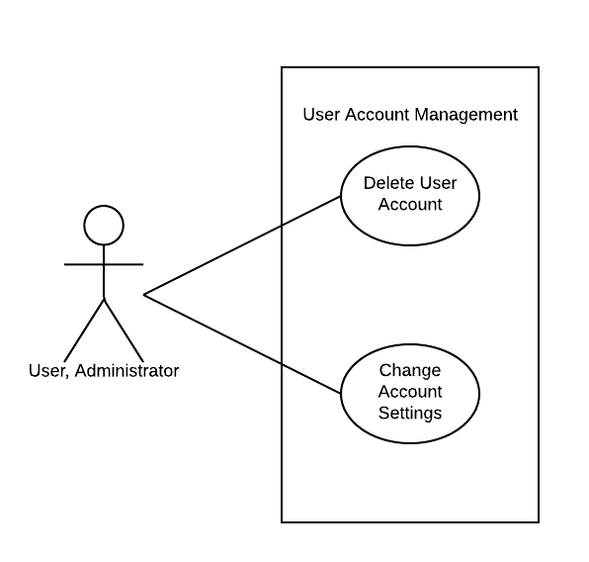
Use Cases
Account Management Diagram

Slide 79
Feasibility Assessment
13
Jeremiah

Slide 80
Feasibility Assessment
What are the primary components examined for the overall scope?
Control water valves
Read soil moisture levels from in-ground sensors
Detect rainfall and terminated watering
Control all features remotely from web application
What research has been done to determine feasibility?
Hardware: soil sensors, water valves, and rain sensors
Software: low level microcontroller programming

Slide 81
Feasibility Assessment
What experiences does the team posses that influenced the technical analysis?
Microcontrollers (both Raspberry Pi and Adruino)
Web Development
Database creation and index optimization
What areas does the team lack experience?
Soil and rain sensors
Water valves and home irrigation
Sprinkler system controllers

Slide 82
Feasibility Assessment
Cost Breakdown Analysis
Part | Cost
Raspberry Pi microcontroller | $70.00
Soil moisture sensor (3) | $20.00
Water valve (3) | $60.00
Web hosting subscription (6 months) | $120.00
Rain sensor | $15.00
Plumbing materials | $25.00
Microcontroller case | $20.00
Sprinkler (3) | $10.00
Waterproof sensor case (3) | $45.00
Miscellaneous parts (wires, adapters, etc) | $50.00
Total | $435.00

Slide 83
Feasibility Assessment
What are the different disciplines that make up SmartGrass?
1 Computer Engineer
1 Software Engineer
2 Computer Scientists
How will they be assigned to optimize development?
CE will focus on the hardware (microcontroller and sensors)
SE will focus on hardware programming and the web application
(1) CS will be focused on the hardware programming
(1) CS will be focused on the web application development

Slide 84
Feasibility Assessment – Schedule Analysis
Function Point Estimation
Program Characteristic | Low Complexity | Medium Complexity | High Complexity | Totals
Number of Inputs | 5 x 3 | 2 x 3 | 0 x 6 | 21
Number of Outputs | 3 x 3 | 1 x 5 | 0 x 7 | 14
Inquiries | 2 x 3 | 0 x 3 | 1 x 6 | 12
Logical Internal Files | 2 x 7 | 1 x 10 | 0 x 15 | 24
External Interface Files | 1 x 5 | 2 x 7 | 1 x 10 | 29
Unadjusted Function-Point Total |  |  |  | 100

Slide 85
Feasibility Assessment – Schedule Analysis
Influence Multipliers
General System Characteristics | Priority Rating (0-5)
Data Communications | 5
Distributed Data Processing | 3
Performance | 5
Heavily Used Configuration | 2
Transaction Rate | 3
On-Line Data Entry | 3
End-User Efficiency | 3
On-Line Update | 0
Complex Processing | 3
Reusability | 1
Installation Ease | 3
Operational Ease | 3
Multiple Sites | 1
Facilitate Change | 2
Total | 30
Adjustment Factor | 1.05

Slide 86
Feasibility Assessment – Schedule Analysis
Jones’ First Order Estimation Class Averages
Kind of Software | Best in Class | Average | Worst in Class
Systems | 0.43 | 0.45 | 0.48
Jones’ First Order Estimation
 | Best Case | Average Case | Worst Case
Adjusted Function-Point Total | 105^0.43 | 105^0.45 | 105^0.48
Total Months | 7.40 | 8.12 | 9.34

Slide 87
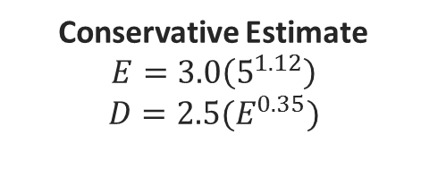
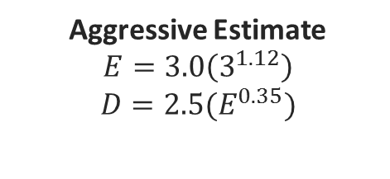
Feasibility Assessment – Schedule Analysis
Basic CoCoMo Estimation Coefficients
Coefficient | a | b | c | d
Semi-detached | 3.0 | 1.12 | 2.5 | 0.35
Aggressive Estimate
$$E=3.0\left(3^{1.12}\right)$$
$$D=2.5(E^{0.35})$$
Conservative Estimate
$$E=3.0\left(5^{1.12}\right)$$
$$D=2.5(E^{0.35})$$
Semi-Detached Basic CoCoMo Estimation
 | Low Side (Aggressive) | High Side (Conservative)
Effort - person months | 10.27 | 18.20
Duration - months | 5.64 | 6.90
People Required | 1.82 | 2.63

Slide 88
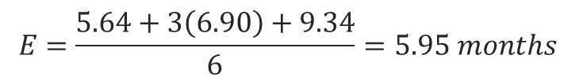
Feasibility Assessment – Schedule Analysis
Weiss & Wysocki Sanity Test
$$E=\frac{5.64+3\left(6.90\right)+9.34}{6}=5.95 months$$
Since 40 hour work weeks isn’t possible if we consider half the hours that’s 12 months for completion!
If we factor in our team of 4 and average our aggressive/conservative estimations our estimated completion time is around 7 months
Just to be safe we recalculated our duration months for 4 team members and recalculated the sanity test which brought us to right around 8 months for completion
What do all these numbers mean? What is the conclusion?

Slide 89
Future Items
14
Tung

Slide 90
Future Items
What does the future hold for HICS?
1. Wireless Sensors Network
Description: Soil moisture sensors could be upgraded to wireless sensors to streamline communication to the central control unit. A wireless sensor network would increase the flexibility in sensor placement and make the installation of the sensors much easier.
Constraints: Wireless sensors require a wireless power source which limits the sensors lifespan. Replaceable or rechargeable batteries would be needed to ensure the sensors can maximize their uptime.

Slide 91
Future Items
What does the future hold for HICS?
2. Standalone Mobile Application
Description: The HICS web application is designed to scale to size for users accessing it via a mobile device. A standalone mobile application that is developed separately from the web application would be a more polished alternative to this approach for mobile users.
Constraints: Creating a separate mobile application would take valuable time and resources away from the core development of this project. In addition, publishing a mobile application would cut into our budget as there is often a fee associated with it.

Slide 92
Future Items
What does the future hold for HICS?
3. Upcoming Weather Alerts
Description: The HICS utilizes rain sensors to avoid watering during rainy weather. However, this method is only useful when it is actually raining. A weather alert feature could pull reports from local weather APIs and alert the user if a scheduled watering event conflicts with upcoming rainy weather.
Constraints: Weather reports would have to be very accurate to the location of the central control unit

Slide 93
Questions?
?
Home Irrigation Control System

